Slide 1
Analysis of the LSTM to Update the Forget Gate to Improve Pattern Learning
By: Preston Robertson
Notes:
Introduce ourself, what we do and the department

Slide 2
Outline
Objective: Analyze and hypothesize how and why the different activation functions have different effects on the LSTM model.
Outline:
Introduction
Literature Review
Forget Gate
Input Gate
Output Gate
Methodology
Squish Activation Function
Experimental Results
Conclusion
Future Work

Slide 3
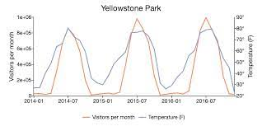
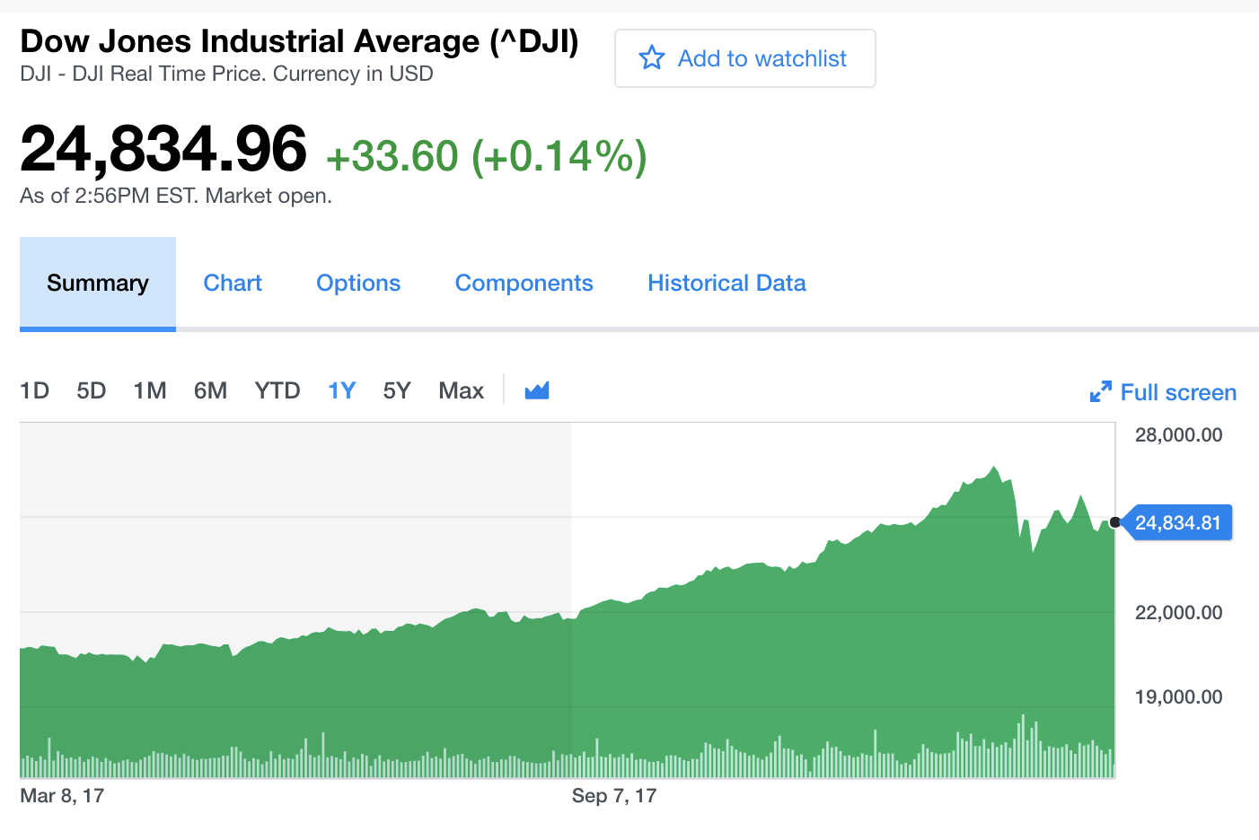
Introduction
Problem:
The problem of analyzing time-series based data has been a goal of researchers, since normal artificial neural network learning can not be directly applied.
Solution:
The architecture of the recurrent neural network (RNN) allows for a feed-forward network that learns from results from previous nodes.
Benefit:
This change to architecture allows for new types of data to be analyzed, such as: video, speech, vibrations, robot control, sign language translation, etc.

Slide 4
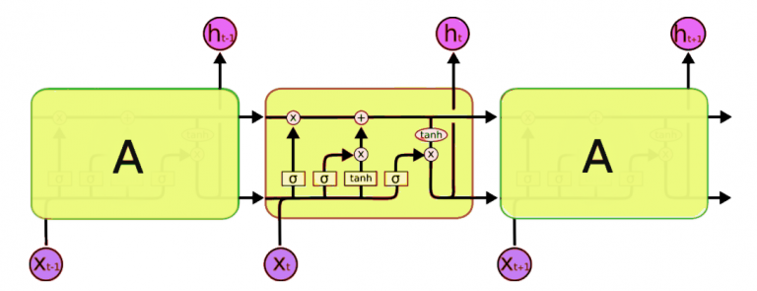
Literature Review
RNN Problem:
The RNN model has a common issue of vanishing gradient over the course of training.
*This vanishing gradient refers to the learning slowdown of the model.
LSTM:
The LSTM was initially created in 1996 to help combat the vanishing gradient.
*The original LSTM model initially only added the cell state to the RNN model.
The LSTM is made from 3 parts:
The Forget Gate
The Input Gate
The Output Gate

Slide 5
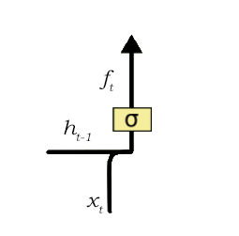

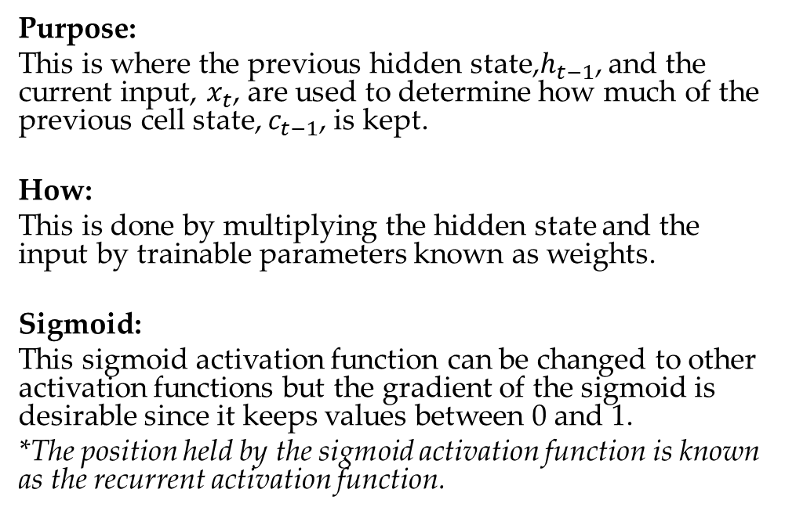
Literature Review: Forget Gate
Purpose:
This is where the previous hidden state,$h_{t−1}$, and the current input, $x_{t}$, are used to determine how much of the previous cell state, $c_{t−1}$, is kept.
How:
This is done by multiplying the hidden state and the input by trainable parameters known as weights.
Sigmoid:
This sigmoid activation function can be changed to other activation functions but the gradient of the sigmoid is desirable since it keeps values between 0 and 1.
*The position held by the sigmoid activation function is known as the recurrent activation function.

Slide 6
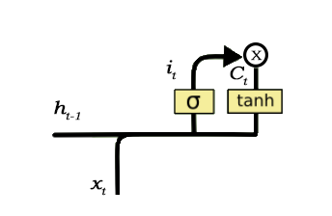
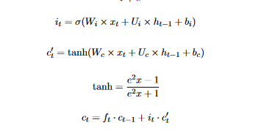
Literature Review: Input Gate
Purpose:
The Input Gate determines how much should the current cell state change to meet current requirements of the LSTM model.
How:
The input gate value is what determines how valuable the new change is to the overall model accuracy.
*The input gate defaults to using the sigmoid function as the recurrent activation function.
How pt.2:
The other value calculated in the input gate step is the suggested change to the cell state.
*This is determined through using the set activation function on the input values of this step.

Slide 7
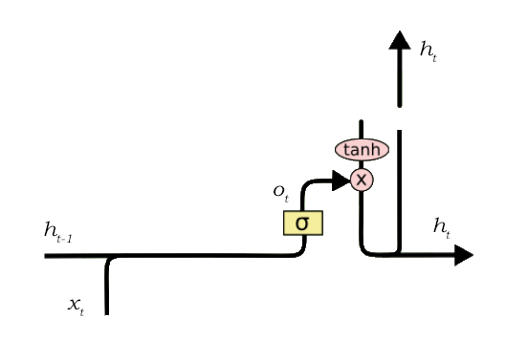

Literature Review: Output Gate
Purpose:
The output gate is where the output of the LSTM cell is decided.
How:
The final value is then taken by multiplying this output gate value by the cell state that is filtered through the set activation function.
Hyperbolic Tangent:
Since it is a bounded function, it also goes from -1 to 1 instead of the sigmoid function only going from 0 to 1.
*This has shown to benefit the LSTM model, to have the ability to have a negative cell state.
What’s Next:
This cell is now complete, and the new hidden state and cell state are then used as the input of the next LSTM cell where the process begins anew.

Slide 8
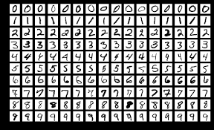
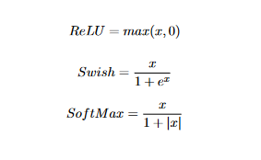
Methodology
Objective:
For the analysis conducted in this project, we will see the different ways that the activation functions can be changed, and how it effects the outcomes.
*The change will be made to both the main activation function and to the recurrent activation functions.
How:
The different activation function will be tested at both activation functions to see the effect on the test accuracy. List of activation functions:
Swish
ReLU
SoftMax
Squish
Dataset:
The data set chosen to run the experiment is the MNIST data set.
*Classification image-based data set that is roughly 60,000 hand drawn images of numbers
Notes:
The ReLU function was chosen due to its overwhelming popularity in most neural networks, and its exploding gradient. The LSTM model’s reaction to an exploding gradient is important to see in this experiment. Another function with an exploding gradient, the Swish was chosen due to the negative side having very valuable gradient information. The comparison between the ReLU Function and the Swish function will show how important the ”swish” in the Swish function is in the LSTM. The Swish was also chosen since it is apart of the Squish function, and comparing them will show how important the differences are. Finally, the SoftMax function was chosen due to its vanishing gradient and it also being apart of the Squish function.

Slide 9
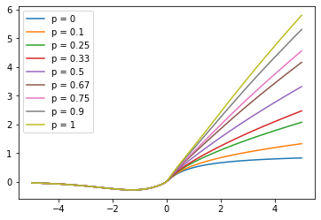

Methodology: Squish
What is the Squish:
The Squish function is a combination function with the objective of capturing properties from several different activation functions.
How:
The combination can be adjusted through this p value.
*Where p is a percentage value for how much inclusion of certain variable will there be.
Combination:
The Squish function is a combination of the Swish and SoftMax functions.
Note:
For the purposes of this experiment, the p value will be set to 0 since it is already known that bounded functions perform the best.
*This is due to time constraints since the average epoch of the Squish is 38x the processing time of the base tanh function.

Slide 10
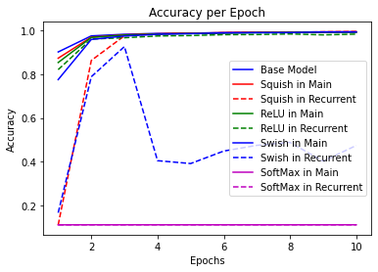
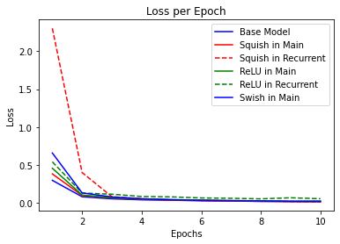
Experimental Results
Activation Function | Location | Loss | Accuracy
Base Model | N/A | 0.03406 | 0.9911
Squish | Main | 0.0379 | 0.9886
Squish | Recurrent | 0.0389 | 0.9897
ReLU | Main | 0.0420 | 0.9872
ReLU | Recurrent | 0.1710 | 0.9424
Swish | Main | 0.0365 | 0.9882
Swish | Recurrent | 1.5770 | 0.4990
SoftMax | Main | 2.3009 | 0.1134
SoftMax | Recurrent | 2.3010 | 0.1135

Slide 11
Conclusion
Results:
The Squish and Swish in the main were top contenders for beating out the base model.
*It seems like the negative component in the main activation function can be of tremendous value.
The Swish/Squish's derivative change in the negative component can also prevent learning slowdown.
*This can be seen through both of there quick convergence rate to the high accuracy scores.
The next thing to not is that the SoftMax function failed, this possibly due to error in calculations or function calling
*However, the recurrent failure of the Swish leads to question of maybe the negative values from the Swish and SoftMax functions led to the convergence failures.
The next major notable result is that the exploding gradient performed almost as well as the vanishing gradient activation functions. This shows that adjusting/tuning the Squish function will most likely lead to great success.

Slide 12
Questions?
Notes:
Ask them to tell us in their own words what AM
History

Slide 13
Possible Future Work
9
Solution 1:
Taking the derivative at each point in the k iteration, instead of taking the values.
*The derivative/gradient will give more useful information but will be much harder to implement. (starting small)
Solution 2:
Implementing a small neural network to detect trends/support vectors to find mt and relay that information to the current cell.
*This would be theoretically more beneficial then averaging the next “k” cell states after mt.
…
Notes:
Ask them to tell us in their own words what AM
History

Slide 14
References
Objective:
…
Method:
…
Set-up:
…
Conclusion:
…
Discussion:
…
Notes:
Ask them to tell us in their own words what AM
History

